Slide 1
Word Problem and
Automatic Groups
By
Akeel Omairi and Muhammad Mohebujjaman

Slide 2
The Purpose Of Our Project
Show a connection between Group Theory and Formal Language Theory.
Mention an interesting subject related to Combinatorial Group Theory.

Slide 3
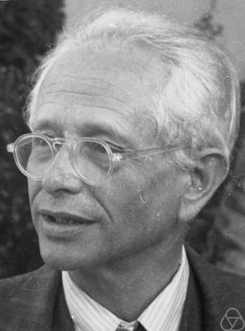
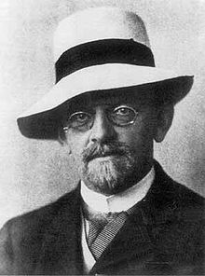
The history of word problem
Max Dehn: (November 13, 1878 – June 27, 1952) was a German American mathematician and a student of David Hilbert.
He formulated the three defining problems in combinatorial group theory that still drive research to this day:
1- word problem.
2-Conjugacy problem.
3- Isomorphism problem.

Slide 4
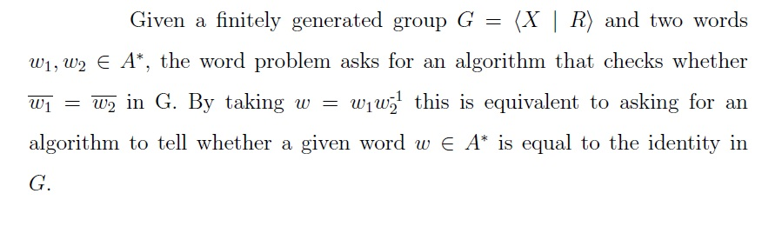
Word Problem

Slide 5
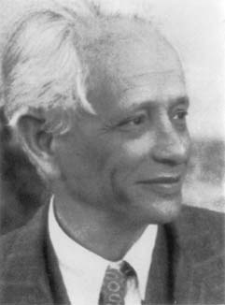
Solving the word problem for all groups may be as impossible as solving all mathematical problems.

Slide 6
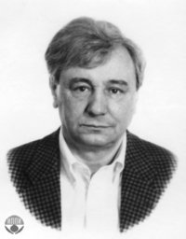
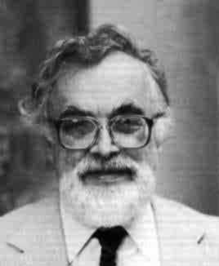
Novikov, Sergei Petrovich
Boone, William Werner
There exists a group G with an unsolvable word problem

Slide 7
Is there a structure on group in which the word problem is solvable?
Automatic structure

Slide 8
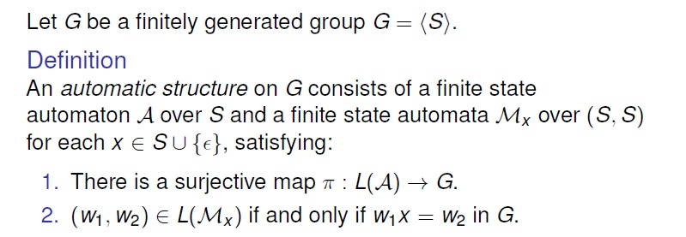
Automatic structure on group
Automatic Group

Slide 9
References
1- Henry, Christopher S., "The (Nested) Word Problem: Formal Languages, Group Theory, and Languages of Nested Words" (2012).
Open Access Dissertations and Theses. Paper 7298.
2- J. J. Rotman. The Theory of Groups. Prentice-Hall, 1981.
3- Tom Edgar. Coxeter Groups and Root Systems via Automatic Structures, Colloquium, Western Washington University, February 2, 2012.
4- http://en.wikipedia.org/wiki/Max_Dehn
5- http://www-history.mcs.st-and.ac.uk/PrintHT/Word_problems.html

Slide 10
Thank you for listening

Slide 11
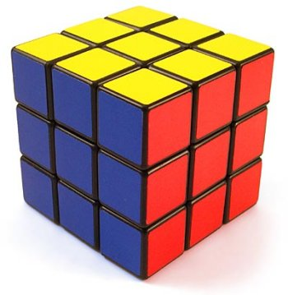
Rubik’s Cube:
There are around possible configurations of a Rubik’s cube of size

Slide 12
Group Operation:
If M1 and M2 are two moves, then M1*M2 is the move when we first do M1 and then do M2. .
The set of moves of a Rubik’s cube forms a group (G, *).
Why is this group?
G is closed under *, since, if M1 and M2 are moves, M1*M2 is a move as well.
If we let e be the “empty” move, then M*e=e*M=M
If M is a move,
the reverse steps, then
, * is associative.
Rubik’s Cube Group:
Finitely generated by the set X={D, U, L, R, F, B}

